Slide 1
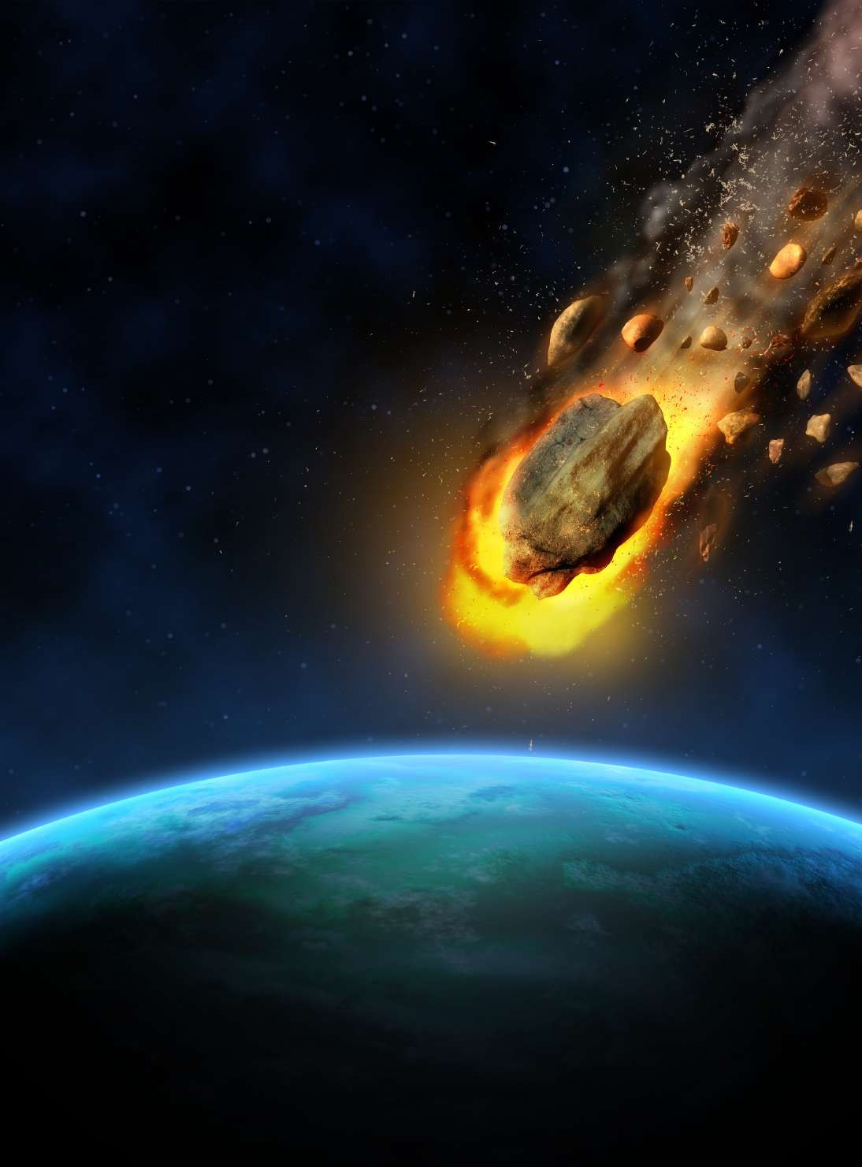

E ploring NASA Asteroids: Machine Learning Classiﬁcation

Slide 2
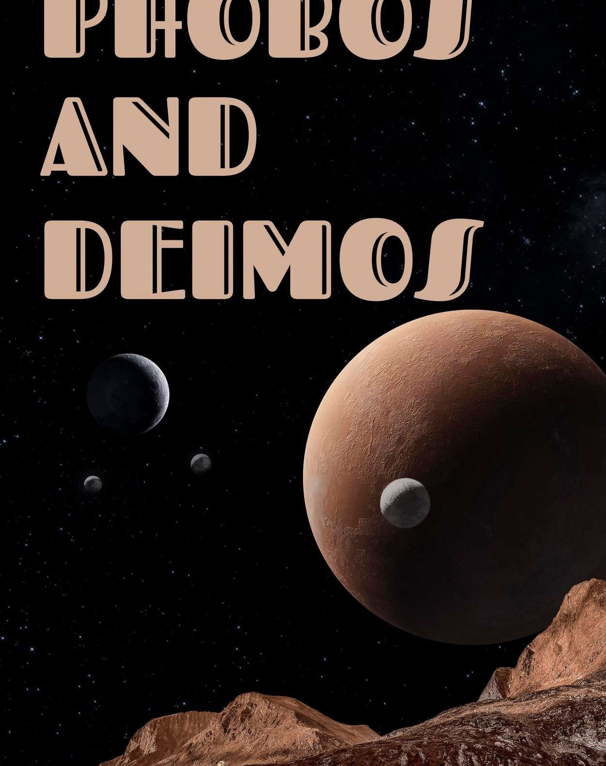
Introduction
Asteroids, remnants of the early solar system, are fascinating objects that orbit the Sun and come in various shapes, sizes, and compositions. NASA has been collecting valuable data on asteroids, offering insights into their characteristics and behavior.
With advancements in technology, particularly in machine learning, there's growing interest in leveraging these tools to understand asteroids better.
Machine learning algorithms can analyze vast datasets, extract patterns, and make predictions,
presenting an opportunity to enhance our understanding of asteroids.

Slide 3
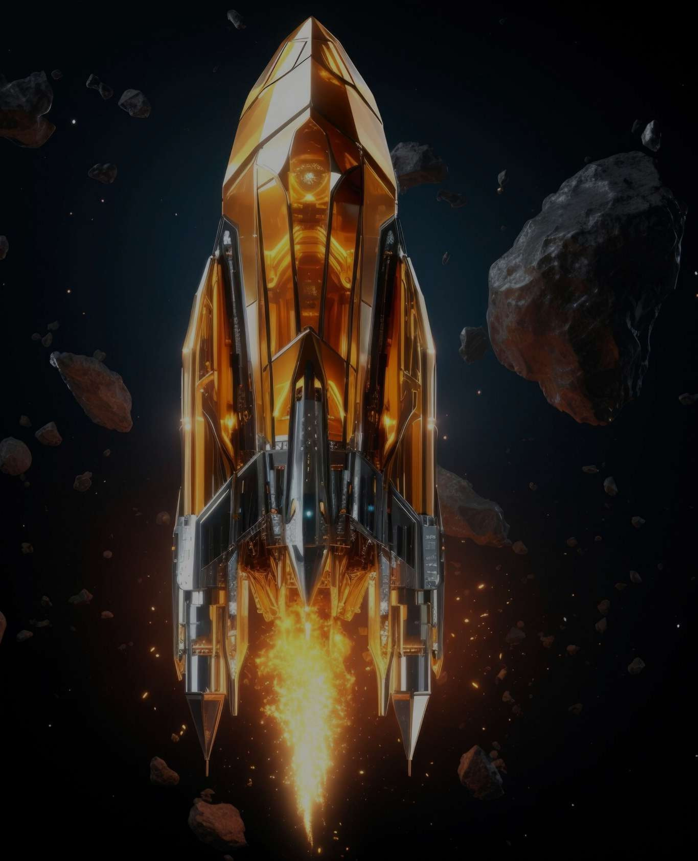
Dataset Description
The dataset consists of 4687 data instances (rows) and 40 features (columns).
Neo Reference ID: Assigned reference ID for each asteroid. Absolute Magnitude: Represents the visual magnitude an observer would record if the asteroid were 1 Astronomical Unit away from the Sun.
Est Dia (in KM) and Est Dia (in M): Estimate diameter of the asteroid in kilometers and meters, respectively.
Relative Velocity (km/sec) and Relative Velocity (km/hr): Denotes the asteroid's relative velocity in km/s and km/hr, respectively.
Hazardous: Indicates whether the asteroid is hazardous or not.

Slide 4

Machine Learning Models
Gaussian Naive Bayes (Gaussian NB): Gaussian NB is a simple probabilistic classiﬁer suitable for tasks with continuous features, like asteroid properties, due to its assumption of feature independence.
Support Vector Machine (SVM): SVM is a powerful algorithm for classiﬁcation tasks, ﬁnding the hyperplane that best separates classes in high-dimensional feature spaces, making it versatile with different kernel functions.
Decision Tree: Decision trees recursively split data into subsets based on feature values, easy to interpret and visualize, suitable for understanding classiﬁcation processes.

Slide 5

Logistic Regression: Logistic regression is a linear model used for binary classiﬁcation tasks, efﬁciently modeling class probabilities with a logistic (sigmoid) function.
K-Nearest Neighbors (KNN): KNN assigns class labels based on the majority vote of the k nearest neighbors in feature space, simple and intuitive but may suffer from high-dimensional data.
Random Forest: Random Forest constructs multiple decision trees during training, reducing overﬁtting and increasing accuracy through bagging and feature randomization.
LightGBM: LightGBM is a gradient boosting framework known for speed and efﬁciency, employing a leaf-wise tree growth strategy and histogram-based splitting, suitable for high-dimensional classiﬁcation tasks.

Slide 6
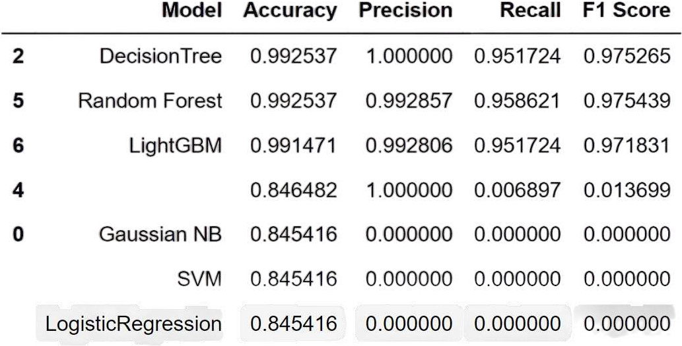
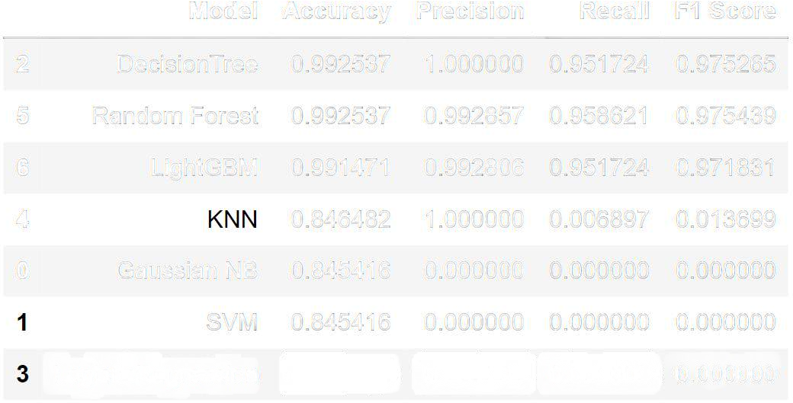
To assess the performance of our models, we employed a range of metrics including accuracy,
precision, recall, and F1 score.
Model Evaluation
Upon analysis, we found that Decision Tree, Random Forest, LightGBM, and KNN displayed commendable results. These models exhibited higher precision and recall values, indicating their capability to effectively classify positive instances
within the asteroid dataset.
However, Gaussian Naive Bayes, Logistic Regression, and SVM showed limited success, with precision and recall scores of 0. This suggests an inability to correctly predict any positive outcomes, rendering these models unsuitable for the task at hand.

Slide 7
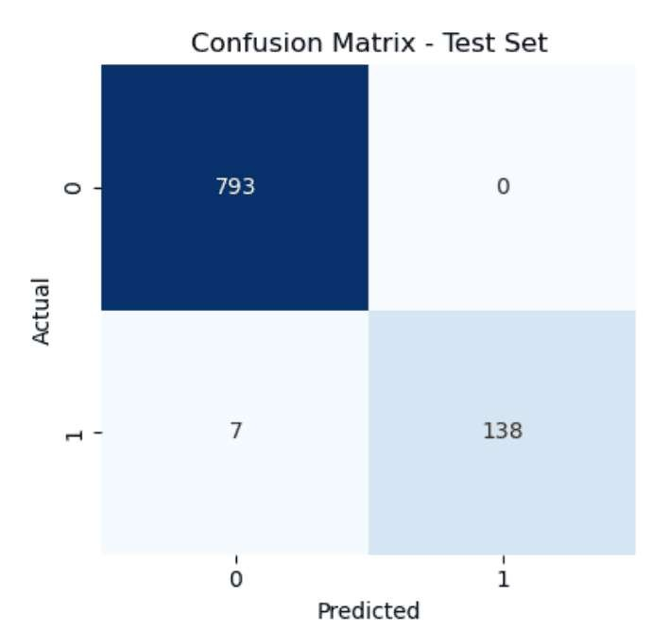
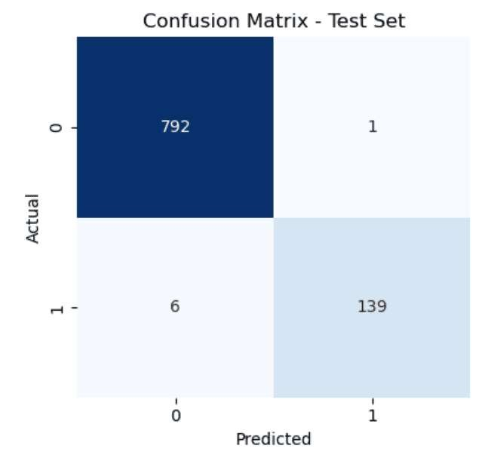
Random Forest
Decision Tree

Slide 8
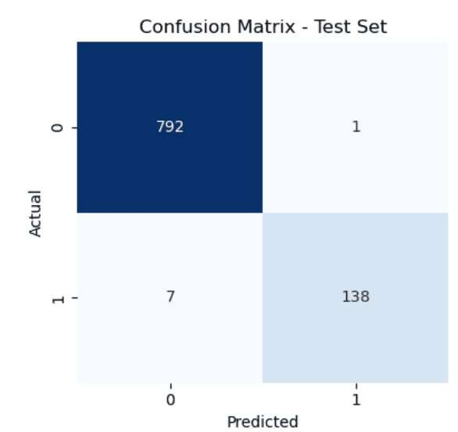
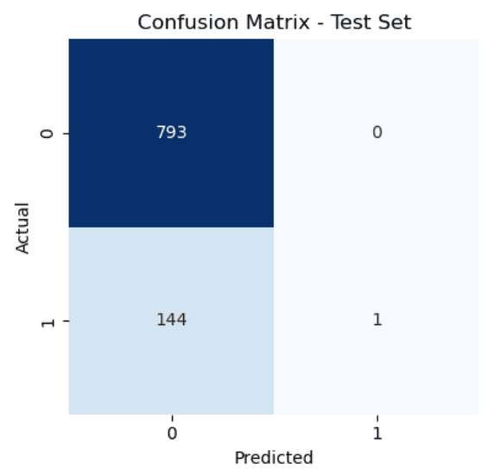
K-Nearest Neighbours
LightGBM

Slide 9
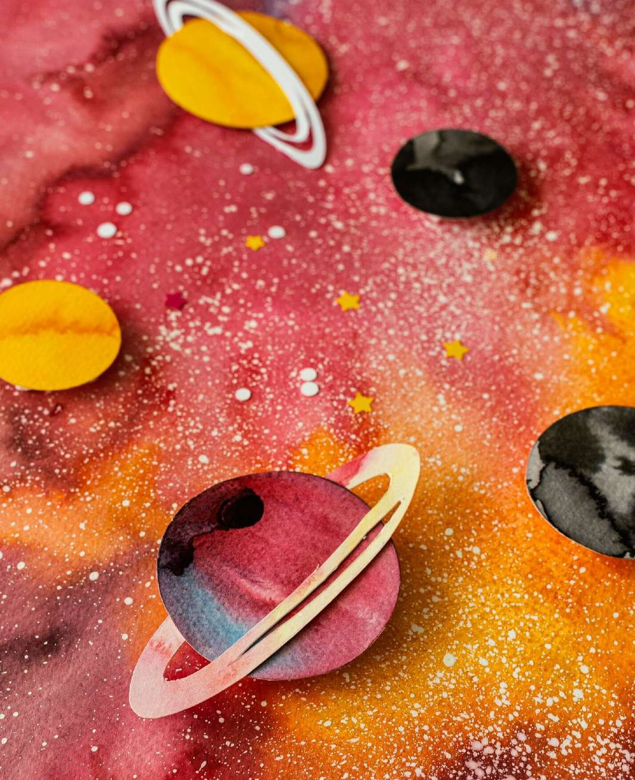
Challenges and Limitations
Asteroid classiﬁcation encountered many challenges such as sourcing labeled data, handling noise in observational data, addressing class imbalance, ensuring model generalization, and interpreting complex model outputs.
Additionally, considerations of data quality, model robustness, and ethical implications of misclassiﬁcations are also considerable difﬁculties.

Slide 10
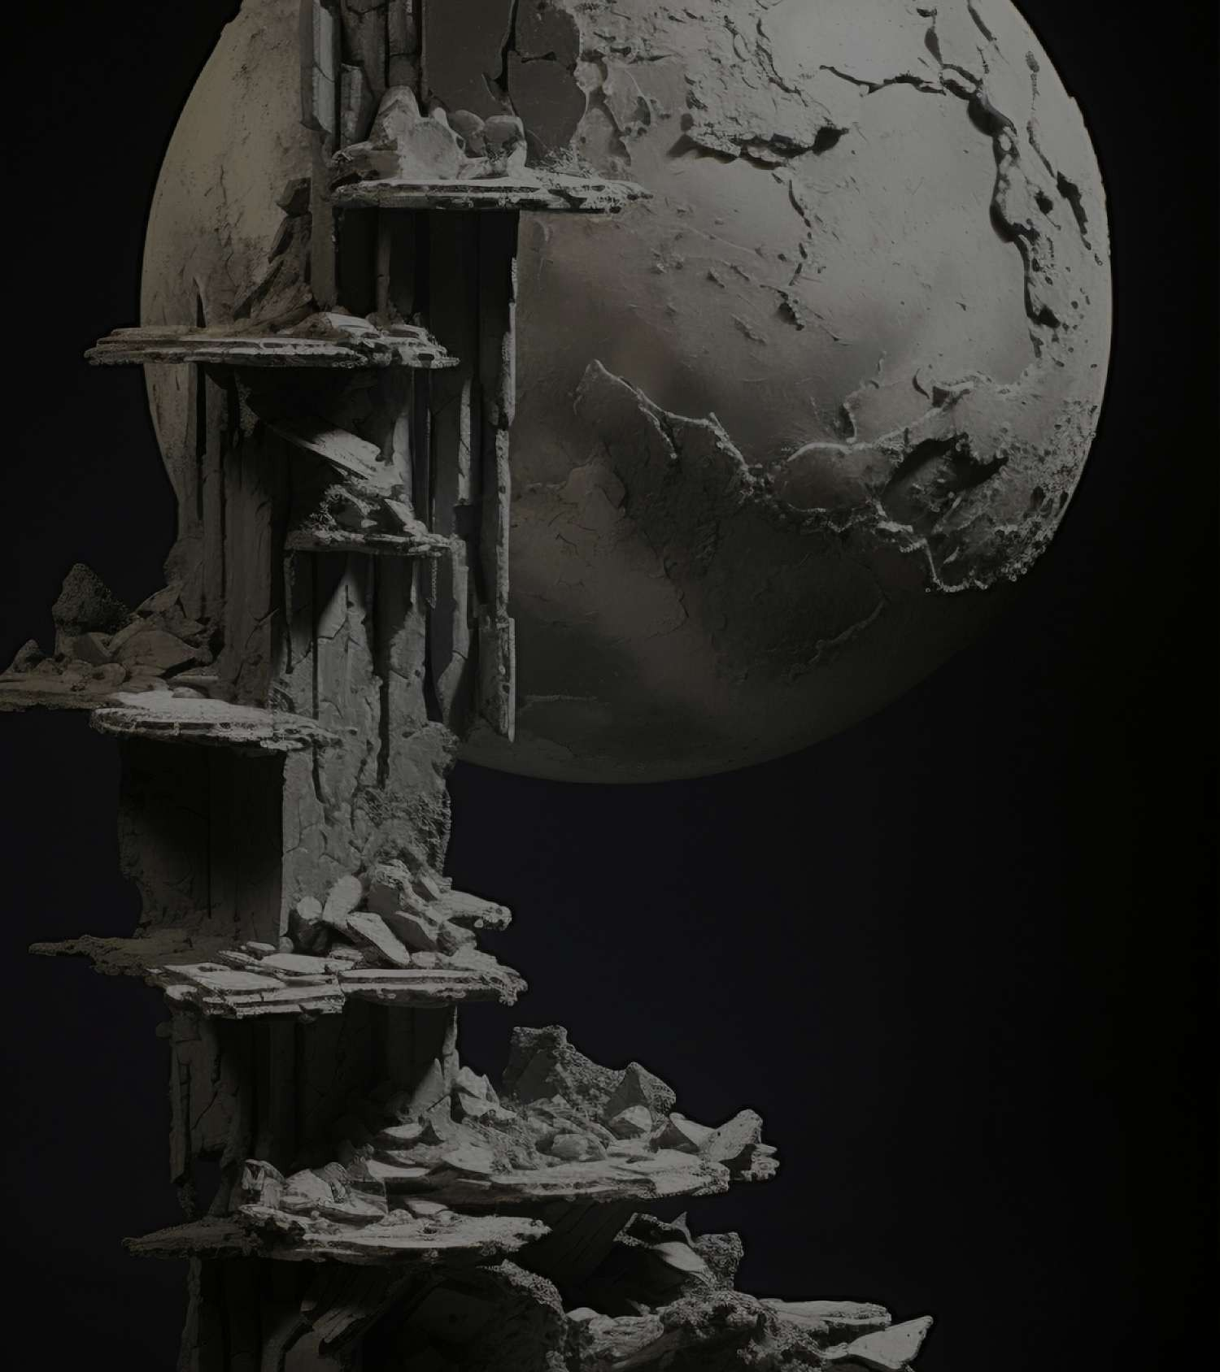
Conclusion
The exploration of NASA asteroids through machine learning classiﬁcation unveils insights into their characteristics and behaviors, despite challenges
like data scarcity and noise.
The study underscores the potential for continued advancements in understanding and monitoring asteroids, enabling proactive measures for planetary defense and space exploration.
By leveraging machine learning techniques, we pave the way for improved accuracy in asteroid classiﬁcation, contributing to broader scientiﬁc understanding and mitigation strategies for potential threats from near-Earth objects.

Slide 11
Thanks!
Hensika Bishnoi (E23MCAG0004) Eeva Mehra (E23MCAG0049) Aakriti Jain (E23MCAG0131)

